Slide 1

Employee Management System

Slide 2
TEAM MEMBERS
Leader : Shaik Jabeena
LinkedIn : https://www.linkedin.com/in/jabeenashaik31/
Teammate 1 : Kopuri poojitha
Linkedln : https://www.linkedin.com/in/kopuri-poojitha-13031638b/
Teammate 2 : Chimata Varalakshmi
Linkedln : https://www.linkedin.com/in/varalakshmi-chimata/

Slide 3
AGENDA
Objective of the Project
ER Diagram and Schema Explanation
Key analysis questions
Conclusion
Experience

Slide 4
Objective of the Project
To design and develop an Employee Management System using SQL.
To efficiently store and manage employee information, job roles, departments, qualifications, leave records, and payroll details.
To maintain data accuracy and consistency using primary keys, foreign keys, and relational database concepts.
To simplify HR operations by providing easy access to employee data and generating meaningful reports.
To perform data analysis on employee insights, salary distribution, department performance, leave patterns, and payroll management for better decision-making.
To improve employee record management by reducing data redundancy and ensuring secure data storage.
To support quick information retrieval and efficient decision-making through structured SQL queries and reports.

Slide 5
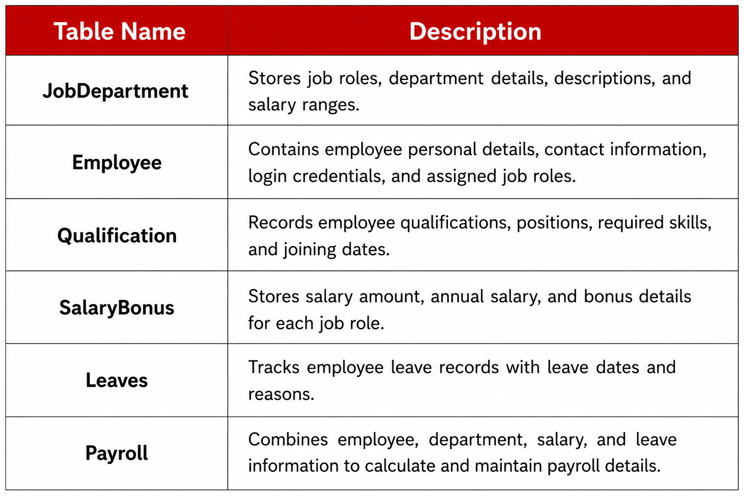
INTRODUCTION
The project analyzes and manages an organization's employee data to improve HR operations, payroll processing, leave management, and employee performance tracking. The dataset consists of six interrelated tables that store employee, department, qualification, salary, leave, and payroll information.

Slide 6
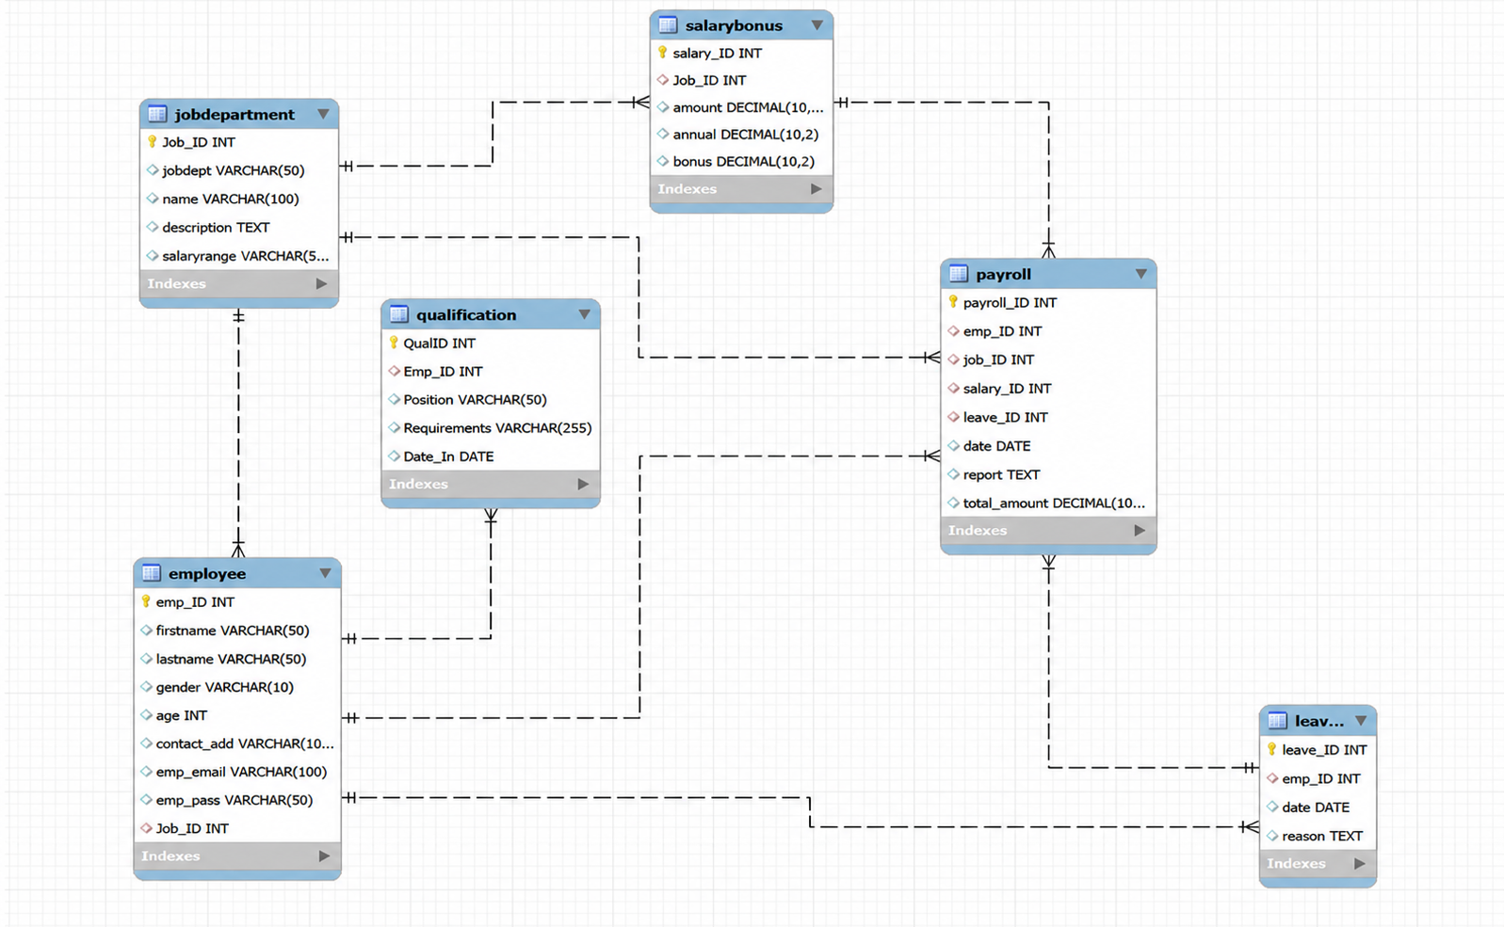
ER Diagram

Slide 7
1.Job Department → Employee
Relationship: One-to-Many (1 : M)department.
Explanation:
One department can have many employees,
but each employee belongs to only one
Foreign Key:
Employee.Job_id → Job Department.Job_id
2. Job Department → Salary Bonus
Relationship: One-to-Many (1 : M)
Explanation:
One department can have many salary records,
but each salary record belongs to only one department.
Foreign Key:
SalaryBonus.Job_ID → JobDepartment.Job_ID

Slide 8
3. Employee → Qualification
Relationship: One-to-Many (1 : M)
Explanation:
One employee can have multiple qualification records,
but each qualification record belongs to only one employee.
Foreign Key:
Qualification.Emp_ID → Employee.Emp_ID
4. Employee → Leaves
Relationship: One-to-Many (1 : M)
Explanation:
One employee can apply for many leaves,
but each leave record belongs to only one employee.
Foreign Key:
Leaves.Emp_ID → Employee.Emp_ID

Slide 9
5. Employee → Payroll
Relationship: One-to-Many (1 : M)
Explanation:
One employee can have multiple payroll records,
but each payroll record belongs to only one employee.
Foreign Key:
Payroll.Emp_ID → Employee.Emp_ID
6. JobDepartment → Payroll
Relationship: One-to-Many (1 : M)
Explanation:
One department can have many payroll records,
but each payroll record belongs to only one department.
Foreign Key:
Payroll.Job_ID → JobDepartment.Job_ID

Slide 10
7. SalaryBonus → Payroll
Relationship: One-to-Many (1 : M)
Explanation:
One salary record can be used in many payroll records,
but each payroll record refers to only one salary record.
Foreign Key:
Payroll.Salary_ID → SalaryBonus.Salary_ID
8. Leaves → Payroll
Relationship: One-to-Many (1 : M)
Explanation:
One leave record can be linked to payroll information,
but each payroll record refers to only one leave record.
Foreign Key:
Payroll.Leave_ID → Leaves.Leave_ID

Slide 11
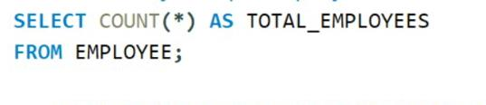

Analysis Questions
1. EMPLOYEE INSIGHTS
How many unique employees are currently in the system?
QUERY:
Key Insights:
Shows the total number of employees in the company.
Helps understand the overall workforce size.
OUTPUT:

Slide 12
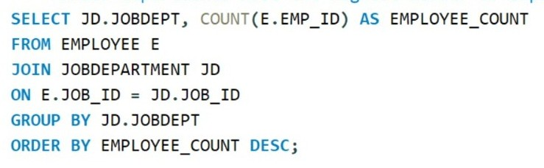
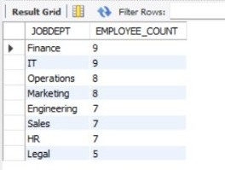
Which departments have the highest number of employees?
QUERY: OUTPUT:
Key Insights:
Shows the number of employees in each department.
Helps identify departments with the highest workforce.

Slide 13
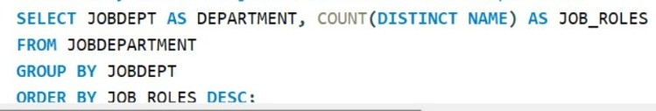
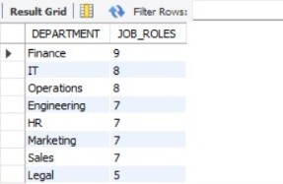
2. JOB ROLE AND DEPARTMENT ANALYSIS
How many different job roles exist in each department?
QUERY: OUTPUT:
Key Insights:
Shows the number of job roles available in each department.
Helps identify departments with the highest variety of job roles

Slide 14
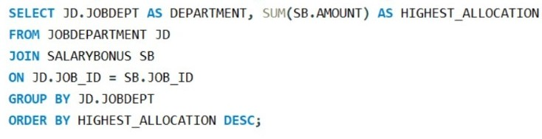
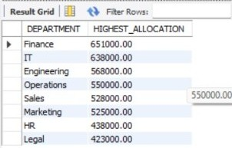
Which departments have the highest total salary allocation?
QUERY OUTPUT:
Key Insights:
Shows the total salary allocation for each department.
Helps identify departments with the highest salary expenditure.

Slide 15
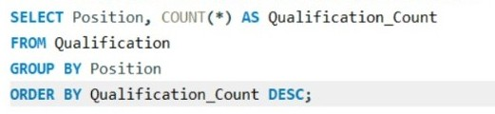
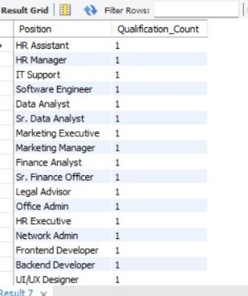
3. QUALIFICATION AND SKILLS ANALYSIS
How which positions requires the most qualification
QUERY: OUTPUT:
Key Insights:
Shows the number of qualifications required for each position.
Helps identify positions with the highest qualification requirements.

Slide 16
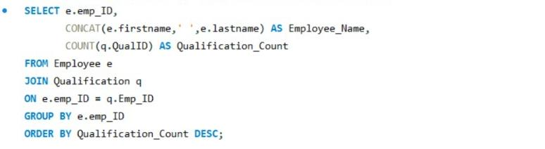
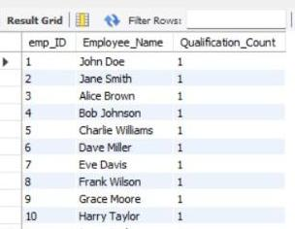
How many employees have at least one qualification listed?
QUERY: OUTPUT:
Key Insights:
Shows employees with the highest number of qualifications.
Helps identify highly skilled and qualified employees within the organization.

Slide 17
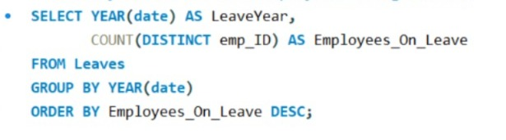
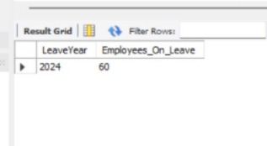
4. Leave And Absence Patterns
Which year had the most employees taking leaves?
QUERY: OUTPUT:
Key Insights:
Helps understand employee leave trends over the years.
Shows which year had the highest number of employees taking leaves.

Slide 18
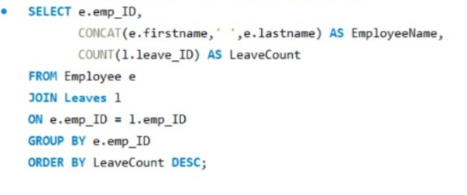
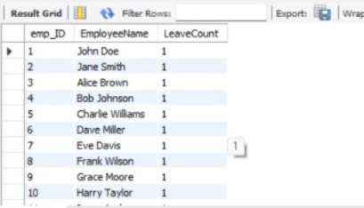
Which employees have taken the most leaves?
QUERY: OUTPUT:
Key Insights:
Shows which employees have taken the most leaves.
Helps identify employees with high leave usage.

Slide 19
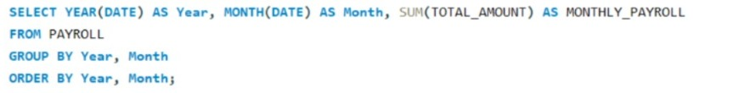
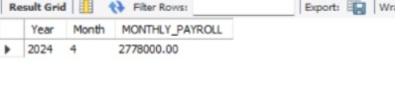
5. Payroll And Compensation Analysis
What is the total monthly payroll processed?
QUERY: OUTPUT:
Key Insights:
Shows the total payroll amount processed each month.
Helps track salary expenses over different months and years.

Slide 20
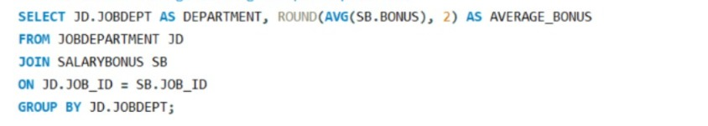
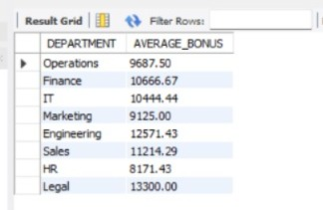
Which department receives the highest total bonuses?
QUERY: OUTPUT:
Key Insights:
Shows which department receives the highest total bonus amount.
Helps identify departments with the highest employee incentive allocation.

Slide 21
Key Insights and Recommendations
Focus on departments with higher employee count by ensuring proper workload distribution and resource allocation to improve overall productivity.
Review salary structures across departments regularly to maintain fair compensation and improve employee satisfaction.
Encourage employees to upgrade their qualifications and skills through training programs to support career growth and organizational development.
Recognize and reward top-performing employees based on payroll, qualifications, or performance metrics to increase motivation and efficiency.
Monitor employee leave patterns to identify frequent absences and implement effective leave management strategies for uninterrupted workflow.

Slide 22
Experience
Developed an Employee Management System using SQL.
Organized employee, department, salary, leave, and payroll data efficiently.
Maintained accurate data using primary and foreign keys.
Generated useful reports using SQL queries and joins. Simplified HR management and improved decision-making

Slide 23
Conclusion
We successfully developed an Employee Management System using SQL.
The system stores employee, department, salary, qualification, leave, and payroll details in an organized way.
We used primary keys and foreign keys to maintain accurate and connected data. SQL queries helped us
analyze employee and payroll information and generate useful reports.
Overall, this project simplifies HR management, reduces manual work, and supports better decision-making.

Slide 24

THANK YOU

